Slide 1

SLICT: Secure Localized Information Centric Things
Marcel Enguehard, Ralph Droms, Dario Rossi
26 September 2016
Workshop on Information Centric Networking for 5G, Kyoto, 2016

Slide 2
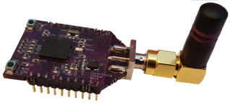

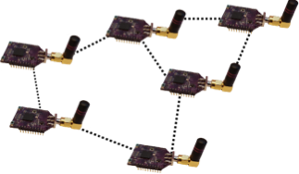
Information Centric Things
Constrained nodes
Broadcast link
Ad-hoc multihop network

Slide 3
ICN for IoT?
Old idea, new method (Intanagonwiwat et al., MOBICOM’00)
Simplicity is better for constrained devices (Bacelli et al., ICN’14)
Security model

Slide 4




Vanilla ICN forwarding for ICT is hard
How do I find this name ?
Interest
/bA/f3/r301/temp
“I want the temperature in the room 301 of building A”
Notes:
Explain name (building A, floor 3, room 301, temperature)

Slide 5
Forwarding for ICN-IoT nodes: challenges
☹
Dynamic topology
☹
Control traffic
☹
Routing state
Notes:
Dynamic topology: interferences, duty cycling, etc.
Control traffic: flood and learn
Routing state: flood and learn does not scale as the number of names augment

Slide 6
Geographic forwarding for ICT is easier
How do I find this position?
Interest
/bA/f3/r301/temp
Interest
/coord/temp
location
“I want the temperature in the room 301 of building A”
Notes:
Topological <-> Geographical location
Name <-> geographical location

Slide 7
Geographic forwarding
☺
Local control traffic
☺
State = list of neighbours
☺
Efficient delivery

Slide 8
GPSR – Greedy and perimeter mode
Greedy forwarding
Perimeter forwarding
Karp et al., Mobicom’ 00

Slide 9
The SLICT framework
Secure
Localized
Information Centric Things
Association protocol
Secure beaconing
Geographic forwarding
ICN stack over RIOT

Slide 10
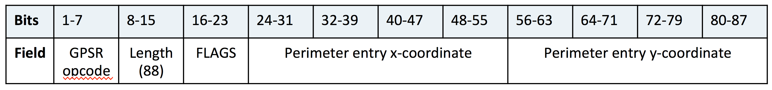
Geographic forwarding for ICThings
Data name: /g/locinf/rest/of/name
FIB entry for /g/:
  Face: virtual face (all neighbours)
  Strategy: GPSR
TLV for additional information

Slide 11
Geographic forwarding for ICThings – cont’d
Forwarder module
Extract name
Forward on selected faces
Returns virtual face + wrapper to GPSR
FIB module
Strategy module
Get faces & strategy
Apply strategy
Computes next node in GPSR

Slide 12
Beaconing for ICThings
n1
n2
n3
Association
Neighbourhood + location updates
Association: See [1]
Encryption through AES broadcast keys
[1] A. Compagno, M. Conti and R. Droms. OnboardICNg: a secure protocol for on-boarding IoT devices in ICN, To appear at ACM ICN’16
Association
Creates persistent
/ndb/n2 pit entry
Creates persistent
/ndb/n2 pit entry
Content message
Name: /ndb/n2
Payload: coordinates, seq num
Updates
n2 position in DB
Updates
n2 position in DB

Slide 13
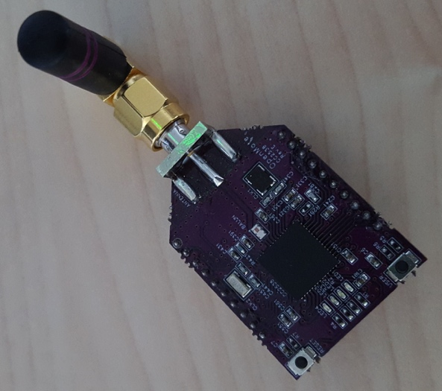
Our IoT hardware
OpenMote
  ARM Cortex-M3 @ 32MHz
  AES+ECC hardware support
  32KB RAM
  512KB ROM
  Open source design

Slide 14
Evaluation setup
Cycle counter in M3
#include <cc2538.h>
#include <stdint.h>
int main () {
uint32_t nb_cycles;
//Enables debug
CoreDebug->DEMCR |= _VAL2FLD(CoreDebug_DEMCR_TRCENA,1);
//Enables cycles counter
DWT->CTRL |= _VAL2FLD(DWT_CTRL_CYCCNTENA,1);
populate_tables ();
//Reinitialises cycle counter
DWT->CYCCNT = 0;
perform_test ();
nb_cycles = DWT->CYCCNT;
...
}

Slide 15
Relative memory & CPU consumption
Geographic forwarding has a smaller memory and CPU footprint
Geographic forwarding has a smaller memory footprint

Slide 16
Forwarding vs cryptography/communication
Geo TLV
Communication & cryptography costs estimated thanks to:
Shafagh et al. Talos: Encrypted Query Processing for the Internet of Things, SenSys’ 15
Notes:
Precise sources for energy consumption

Slide 17
Conclusion
Geographic forwarding can outperform vanilla ICN in memory and CPU
More energy-consuming
Cost of control traffic?

